Slide 1
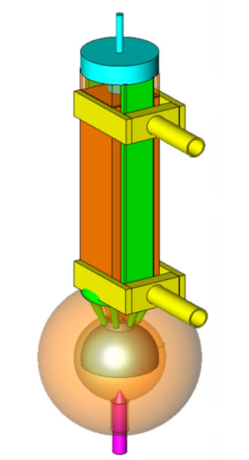
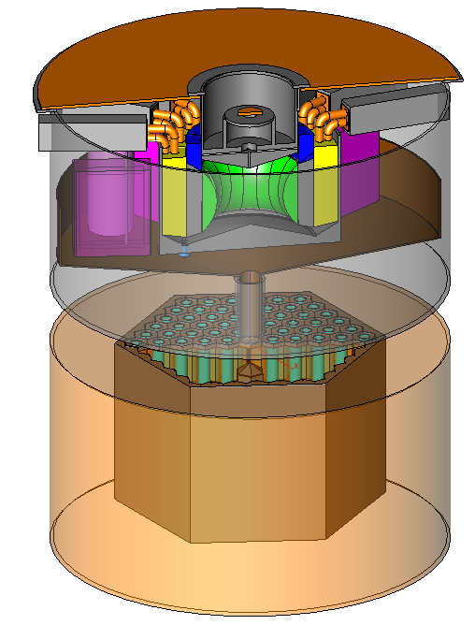







Molten Salt Fast Reactor (MSFR): DESIGN AND INTEGRAL SAFETY ANALYSIS
Prof Elsa MERLE
LPSC France (CNRS-IN2P3 / Grenoble Institute of Technology / UGA)
Michel Allibert, Stéphane Beils, Bernard Carluec, Andrea Carpignano, Sandra Dulla, Yann Flauw, Delphine Gérardin, Alain Gerber, Daniel Heuer, Axel Laureau, Elsa Merle, Brian Sorby, Vincenzo Tiberi, Anna-Chiara Uggenti
AREVA NP, CNRS-IN2P3, IRSN, POLITO
With the support of the National NEEDS Program and the IN2P3 institute of CNRS, of University Grenoble Alpes and Grenoble Institute of Technology, and of the EVOL and SAMOFAR Euratom Projects

Slide 2
Liquid-fueled reactors: why “molten salt reactors”?
Advantages of a Liquid Fuel
  Homogeneity of the fuel (no loading plan)
  Heat is produced directly in the heat transfer fluid
  - No heat transfer delay and very fast thermal feedback
  Possibility to reconfigure passively the geometry of the fuel:
    - One configuration optimizes the electricity production managing the criticality
    - An other configuration allows a long term storage with a passive cooling system
  Possibility to reprocess the fuel without stopping the reactor:
  - Better management of the fission products that damage the neutronic and physicochemical characteristics
  - No reactivity reserve (fertile/fissile matter adjusted during reactor operation)
Which constraints for a liquid fuel?
  Melting temperature not too high
  High boiling temperature
  Low vapor pressure
  Transparent to neutrons
  Good thermal and hydraulic properties (fuel = coolant)
  Stability under irradiation
  Good solubility of fissile and fertile matters
  No production of radio-isotopes hardly manageable
  Solutions to reprocess/control the fuel salt
    Best candidates = fluoride (LiF – 99.995% of ⁷Li) or chloride (NaCl – 99% in ³⁷Cl) salt
      Molten Salt Reactors

Slide 3
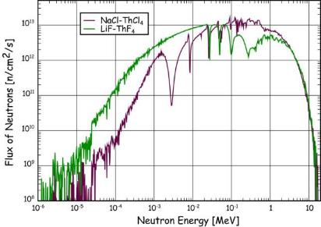
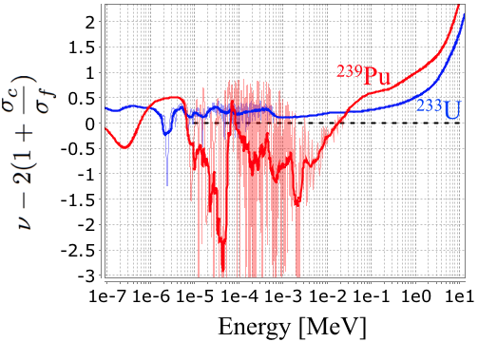
Liquid-fueled reactors: why “molten salt reactors”?
Fluoride versus chloride salt?
      Thorium /²³³U Fuel Cycle
Combination of both neutronic (1) and chemical (2) considerations
    (1) Neutron spectrum: Breeding ratio and irradiation damages
    Neutronic cross-sections of fluorine/chlorine versus neutron economy in the fuel cycle
Parameter | Fluoride Salt | Chloride Salt
Thorium capture cross-section in core (barn) | 0.61 | 0.315
Thorium amount in core (kg) | 42 340 | 47 160
Thorium capture rate in core (mole/day) | 11.03 | 8.48
Thorium capture cross-section in blanket (barn) | 0.91 | 0.48
Thorium amount in the blanket (kg) | 25 930 | 36 400
Thorium capture rate in the blanket (mole/day) | 1.37 | 2.86
²³³U initial inventory (kg) | 5720 | 6867
Neutrons per fission ν in core | 2.50 | 2.51
²³³U capture cross-section in core (barn) | 0.495 | 0.273
²³³U fission cross-section in core (barn) | 4.17 | 2.76
Capture/fission ratio α (spectrum-dependent) | 0.119 | 0.099
Total breeding ratio | 1.126 | 1.040
F[n,n’]
Na[n,γ]

Slide 4
Liquid-fueled reactors: why “molten salt reactors”?
Fluoride versus chloride salt?
Combination of both neutronic (1) and chemical (2) considerations
    (1) Neutron spectrum: Breeding ratio and irradiation damages
    (2) Chemical issues
Element produced | Problem | Fluoride Salt | Chloride Salt
³⁶Cl produced via ³⁵Cl(n,γ)³⁶Cl and ³⁷Cl(n,2n)³⁶Cl | Radioactivity - T_{1/2} = 301000y |  | 10 moles / y (373 g/y)
³H produced via ⁶Li(n,α) t and ⁶Li(n,t) α | Radioactivity - T_{1/2} = 12 years | 55 moles / y (166 g/y)
Sulphur produced via ³⁷Cl(n,α)³⁴P(β-[12.34s])³⁴S and ³⁵Cl(n,α)³²P(β-[14.262 days])³²S | Corrosion (mainly located in the grain boundaries) |  | 10 moles / year
Oxygen produced via ¹⁹F(n,α)¹⁶O | Corrosion (surface of metals) | 88.6 moles/y
Tellurium produced via fissions and extracted by the on-line bubbling | Corrosion (cf. Sulphur) | 200 moles/y | 200 moles/y
Choice of the fluoride salt:
Chemical considerations (production of ³⁶Cl with chloride)
Reduced irradiation damages (spectrum less fast)
Choice of the Th fuel cycle:
Higher breeding ratio with a fluoride salt / spectrum
Smaller production of minor actinides
F[n,n’]
Na[n,γ]
Neutron spectrum less fast with fluoride salt = reduced irradiation damages (both DPA and He production) by a factor 5-7

Slide 5
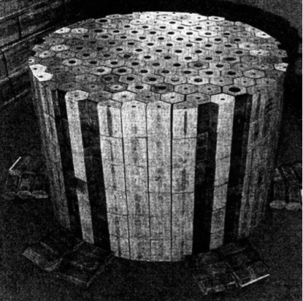
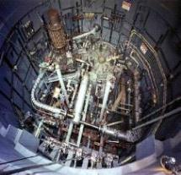
Molten Salt Reactor (MSR): Historical studies
Historical studies of MSR: Oak Ridge Nat. Lab. - USA
1954 : Aircraft Reactor Experiment (ARE)
Operated during 1000 hours
Power = 2.5 MWth
• 1964 – 1969: Molten Salt Reactor Experiment (MSRE)
Experimental Reactor
Power: 7.4 MWth
Temperature: 650°C
U enriched 30% (1966 - 1968)
²³³U (1968 – 1969) - ²³⁹Pu (1969)
No Thorium inside
1970 - 1976: Molten Salt Breeder Reactor (MSBR)
Never built
Power: 2500 MWth
Thermal neutron spectrum

Slide 6
MSR - Renewal of the concept – CNRS studies
Participation to the project TIER I of C. Bowman (1998)
Re-evaluation of the MSBR from 1999 to 2002
  Use of a probabilistic neutronic code (MCNP)
  Development of an in-house evolution code for materials (REM)
  Coupling of the neutronic code with the evolution code
From the Thorium Molten Salt Reactor to the Molten Salt Fast Reactor
  Breeder in the Thorium fuel cycle and Actinide Burner Reactor
  Developed to solve the problems of the MSBR project
      Bad (null to positive) thermal feedback coefficients
      Positive void coefficient
      Unrealistic reprocessing
      Problems specific to the graphite moderator
        Lifespan
        Reprocessing and storage
        Fire risk
PhD thesis of Alexis NUTTIN

Slide 7
MSR - Renewal of the concept – CNRS studies
  Homogeneity of the fuel (no loading plan)
  Heat produced directly in the heat transfer fluid
  Possibility to reconfigure quickly and passively the geometry of the fuel (gravitational draining)
  Possibility to reprocess the fuel without stopping the reactor
Safety: negative feedback coefficients
Sustainability: reduce irradiation damages in the core
Deployment: good breeding of the fuel + reduced initial fissile inventory
Neutronic Optimization of MSR
(Gen4 criteria) :
7

Slide 8


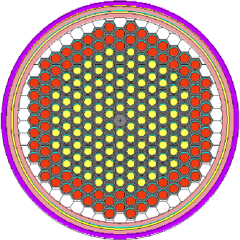
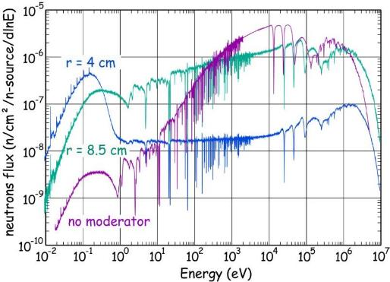

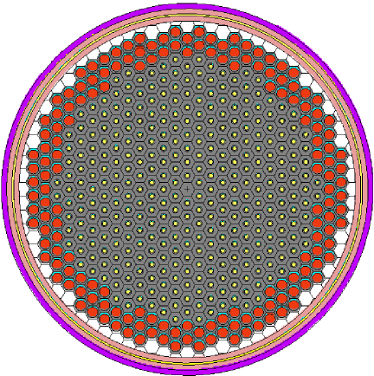

single channel
Historical MSR Studies at CNRS
Influence of the channel radius (moderation ratio)
3 different moderation ratios:
r = 8.5 cm
r = 4 cm
@ L. Mathieu
thermal
fast
- core volume adjusted to keep the same salt volume -

Slide 9
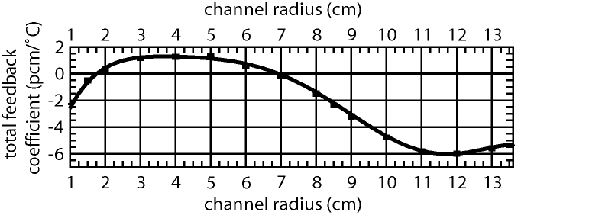
Historical MSR Studies at CNRS
Influence of the moderation on the core behavior
Influence studied through
4 core characteristics:
- Total feedback coefficient
Total feedback coefficient:
Ok if <0 at least

Slide 10
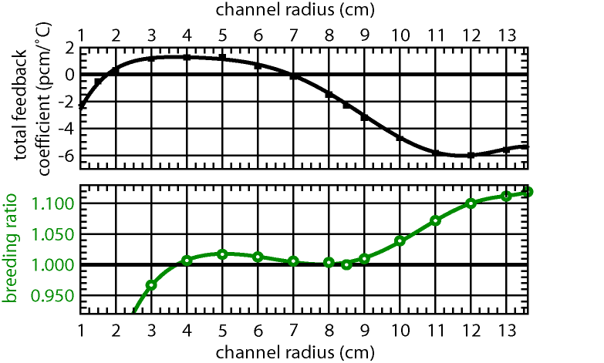
Historical MSR Studies at CNRS
Influence of the moderation on the core behavior
Influence studied through
4 core characteristics:
- Total feedback coefficient
- Breeding ratio:
²³²Th/²³³U cycle: neutron balance better in thermal or fast spectrum
+
neutron captures in moderator in thermal spectrum

Slide 11
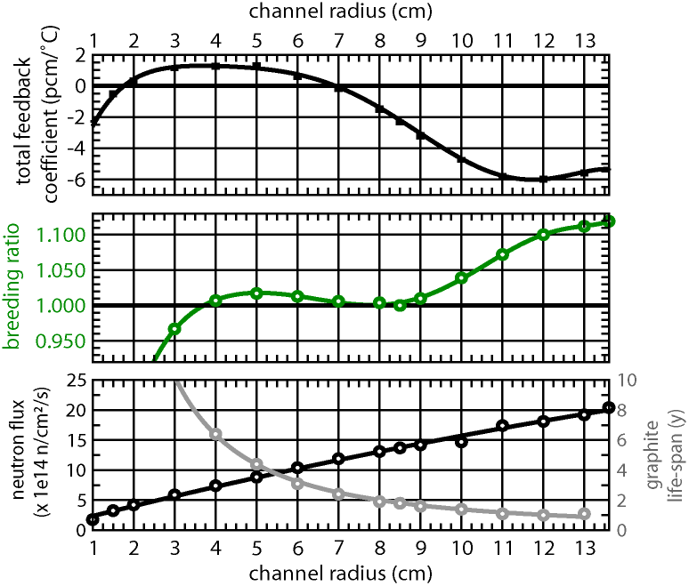
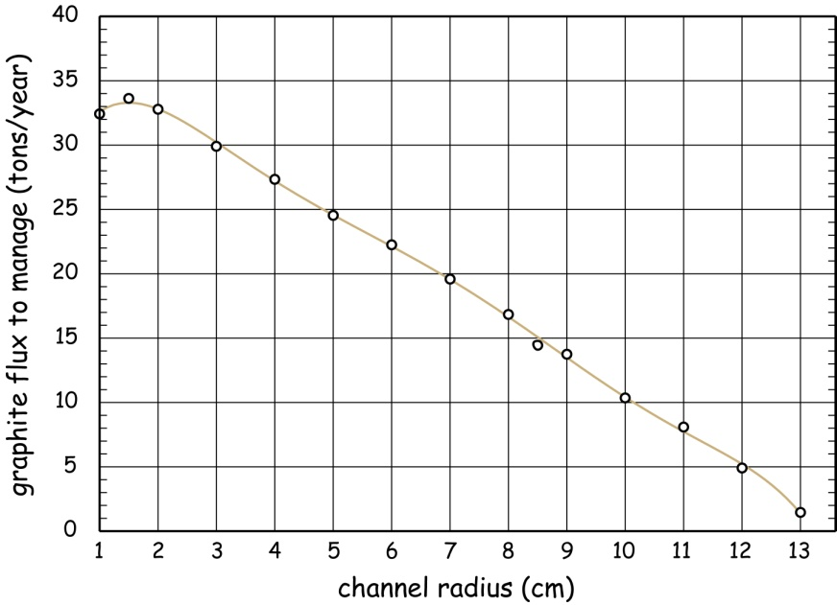
Historical MSR Studies at CNRS
Influence of the moderation on the core behavior
Influence studied through
4 core characteristics:
- Total feedback coefficient
- Breeding ratio
- Neutron flux / Graphite lifespan
+
no graphite moderator

Slide 12
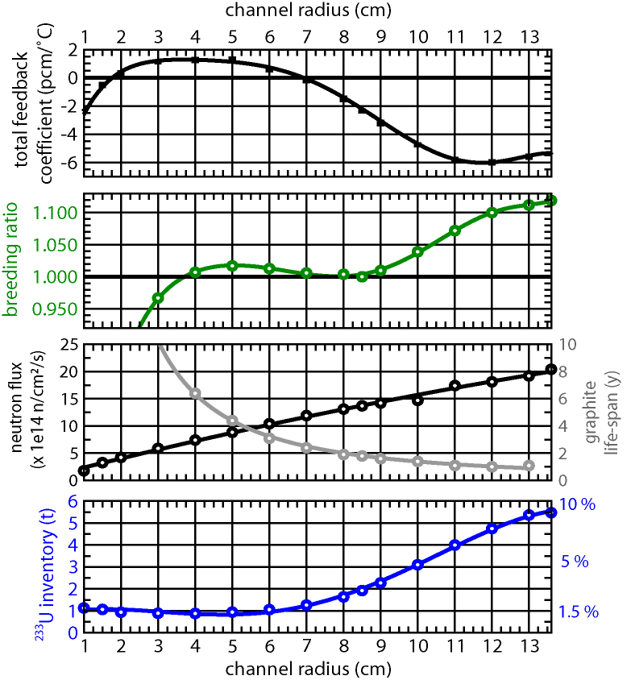
Historical MSR Studies at CNRS
Influence of the moderation on the core behavior
Three types of configuration:
thermal (r = 3-6 cm)
epithermal (r = 6-10 cm)
fast (r > 10 cm)

Slide 13
Historical MSR Studies at CNRS
Influence of the moderation on the core behavior
Thermal spectrum configurations
- positive feedback coefficient
PhD thesis of Ludovic MATHIEU
- iso-breeder
- quite long graphite life-span
- low ²³³U initial inventory
Epithermal spectrum configurations
- quite negative feedback coefficient
iso-breeder
- very short graphite life-span
- quite low ²³³U initial inventory
Fast spectrum configurations (no moderator)
- very negative feedback coefficients
- very good breeding ratio
- no problem of graphite life-span
- large ²³³U initial inventory

Slide 14
Historical MSR Studies at CNRS
Thermal spectrum configurations
- positive feedback coefficient
- iso-breeder
- quite long graphite life-span
- low ²³³U initial inventory
Epithermal spectrum configurations
- quite negative feedback coefficient
iso-breeder
- very short graphite life-span
- quite low ²³³U initial inventory
Fast spectrum configurations (no moderator)
- very negative feedback coefficients
The Molten Salt Fast Reactor - MSFR
- very good breeding ratio
- no problem of graphite life-span
- large ²³³U initial inventory

Slide 15
MSFR: Design and Fissile Inventory Optimization
Reactor Design and Fissile Inventory Optimization = Specific Power Optimization
2 parameters:
The produced power
The fuel salt volume and the core geometry
Liquid fuel and no solid matter inside the core ⇒ possibility to reach specific power much higher than in a solid fuel
3 limiting factors:
The capacities of the heat exchangers in terms of heat extraction and the associated pressure drops (pumps) → large fuel salt volume and small specific power
The neutronic irradiation damages to the structural materials (in Ni-Cr-W alloy) which modify their physicochemical properties. Three effects: displacements per atom, production of Helium gas, transmutation of Tungsten in Osmium → large fuel salt volume and small specific power
The neutronic characteristics of the reactor in terms of burning efficiencies → small fuel salt volume and large specific power and of deployment capacities, i.e. breeding ratio (= ²³³U production) versus fissile inventory → optimum near 15-20 m³ and 300-400 W/cm³
⇒ Reference MSFR configuration with 18 m³ and 330 W/cm³ corresponding to an initial fissile inventory of 3.5 tons per GWe

Slide 16
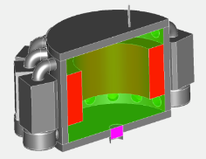


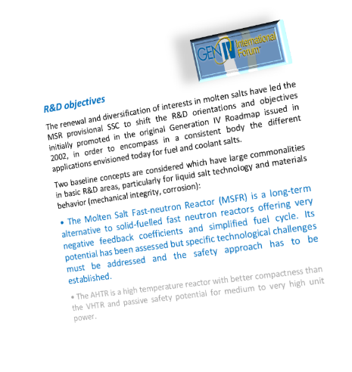
Concept of Molten Salt Fast Reactor (MSFR)
  Homogeneity of the fuel (no loading plan)
  Heat produced directly in the heat transfer fluid
  Possibility to reconfigure quickly and passively the geometry of the fuel (gravitational draining)
  Possibility to reprocess the fuel without stopping the reactor:
Safety: negative feedback coefficients
Sustainability: reduce irradiation damages in the core
Deployment: good breeding of the fuel + reduced initial fissile inventory
Neutronic Optimization of MSR
(Gen4 criteria) :
2008: Definition of an innovative MSR concept based on a fast neutron spectrum, and called MSFR (Molten Salt Fast Reactor) by the GIF Policy Group
    All feedback thermal coefficients negative
    No solid material in the high flux area: reduction of the waste production of irradiated structural elements and less in core maintenance operations
    Good breeding of the fissile matter thanks to the fast neutron spectrum
    Actinides burning improved thanks to the fast neutron spectrum
16

Slide 17
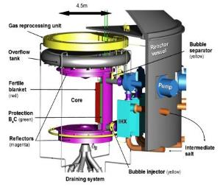

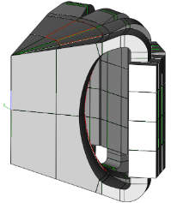
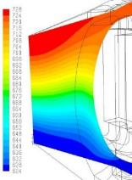
MSFR and the European project EVOL
European Project “EVOL” Evaluation and Viability Of Liquid fuel fast reactor - FP7 (2011-2013): Euratom/Rosatom cooperation
Objective : to propose a design of MSFR given the best system configuration issued from physical, chemical and material studies
WP2: Design and Safety
WP3: Fuel Salt Chemistry and Reprocessing
WP4: Structural Materials
Examples of outputs of the project:
- Optimized toroidal shape of the core
- Neutronic benchmark (comparison tools/ nuclear databases)
- Proposal for an optimized initial fuel salt composition
- First developments of a safety assessment method for MSR
- Recommendations for the choice of the core structural materials
°C
12 European Partners: France (CNRS: Coordinator, Grenoble INP , INOPRO, Aubert&Duval), Netherlands (Technical Univ Delft), Germany (ITU, KIT-G, HZDR), Italy (Politecnico di Torino), UK (Oxford), Hungary (Tech Univ Budapest)
+ 2 observers since 2012: Politecnico di Milano and Paul Scherrer Institute
+ Coupled to the MARS (Minor Actinides Recycling in Molten Salt) project of ROSATOM (2011-2013)
Partners: RIAR (Dimitrovgrad), KI (Moscow), VNIITF (Snezinsk), IHTE (Ekateriburg), VNIKHT (Moscow) et MUCATEX (Moscow)

Slide 18



Concept of MSFR: Fuel processing
4th Generation reactors => Breeder reactors
Fuel processing mandatory to recover the produced fissile matter – Liquid fuel = processing in-situ during reactor operation
Fission Products Extraction: Motivations
Control physicochemical properties of the salt (control deposit, erosion and corrosion phenomena)
Keep good neutronic properties
Processing by batch of 10-40 l per day
Gas extraction
@ V. Ghetta
Gas injection

Slide 19
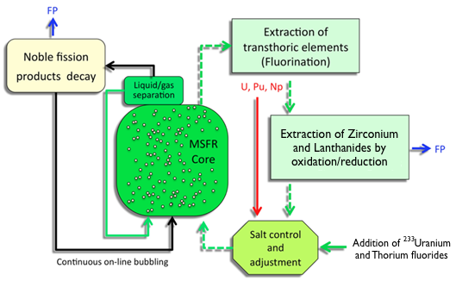
Concept of MSFR: Fuel processing
4th Generation reactors => Breeder reactors
Fuel processing mandatory to recover the produced fissile matter – Liquid fuel = processing in-situ during reactor operation
Fission Products Extraction: Motivations
Control physicochemical properties of the salt (control deposit, erosion and corrosion phenomena)
Keep good neutronic properties
Physical Separation (in the core?)
Gas Processing Unit involving bubbling extraction
Extract Kr, Xe, He and particles in suspension
Chemical Separation (by batch)
Pyrochemical processing Unit
Located on-site, but outside the reactor vessel
S. Delpech, E. Merle-Lucotte, D. Heuer, M. Allibert, V. Ghetta, C. Le-Brun, L. Mathieu, G. Picard, “Reactor physics and reprocessing scheme for innovative molten salt reactor system”, J. of Fluorine Chemistry, 130 Issue 1, p. 11-17 (2009)

Slide 20
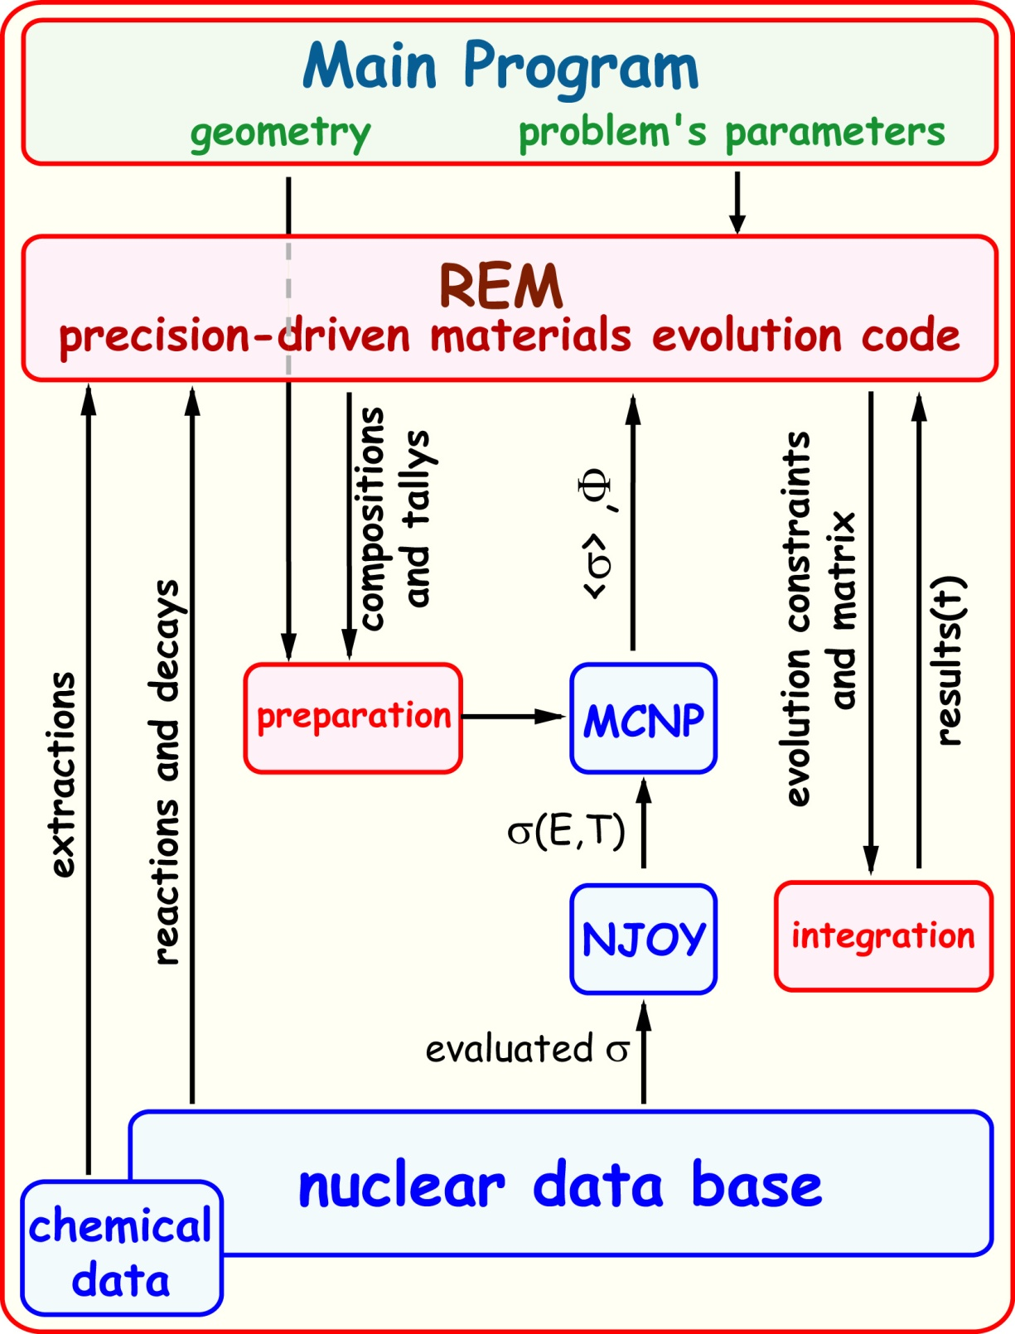
Tools for the Simulation of Reactor Evolution:
Evolving Monte-Carlo calculations
Coupling of the in-house code REM for materials evolution with the probabilistic code MCNP for neutronic calculations

Slide 21
Tools for the Simulation of Reactor Evolution:
Integration Module: Bateman Equation for nucleus i
PhD thesis of Xavier DOLIGEZ
Bateman Equation for nucleus i (in the whole system):
production by radioactive decay
with
‘B’ = location of nucleus i in the sub-system B
‘B → C’ = transfer from sub-system B to sub-system C
production by nuclear reaction
disappearance by nuclear reaction
disappearance by radioactive decay
Calculation of the evolution of matter in each part of the system
⇒ Determination of isotopes concentrations, gamma or neutron flux + the residual heat (fundamental data for radioprotection) everywhere (core, reprocessing unit, bubbling system, draining tanks…) – Basis of the design and of the safety and radioprotection assessment of the whole system

Slide 22
Concept of MSFR: Fuel processing
Batch chemical processing:
Element | Absorption (per fission neutron)
Heavy Nuclei | 0.9
Alkalines | < 10⁻⁴
Metals | 0.0014
Lanthanides | 0.006
Total FPs | 0.0075
PhD thesis of Xavier DOLIGEZ
On-line (bubbling) processing:
@ X. Doligez
Fast neutron spectrum
very low capture cross-sections
⇒ low impact of the processing (chemical and bubbling) on neutronics
Parallel studies of chemical and neutronic issues possible

Slide 23
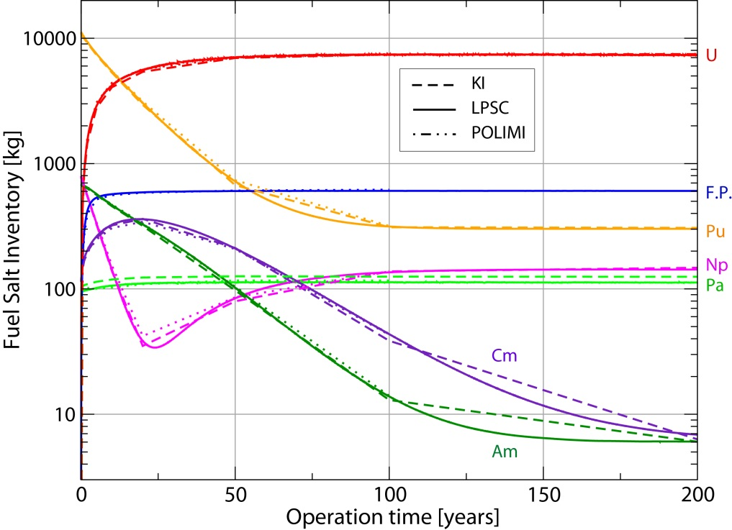
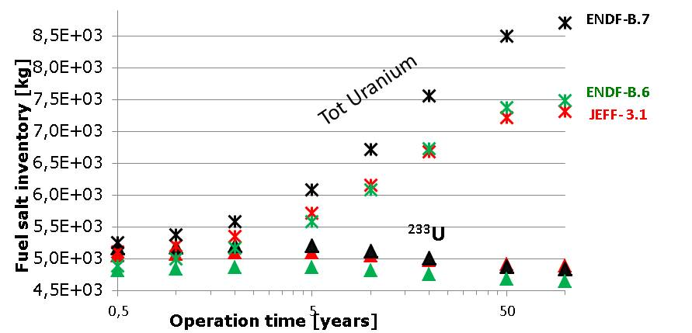
Concept of MSFR: EVOL neutronic benchmark
Largely negative feedback coefficients, ∀ the simulation tool and the nuclear database used
Database: ENDF-B6
PhD Thesis of M. Brovchenko
TRU-started MSFR
Very good agreement between the different simulation tools – High impact of the nuclear database
23

Slide 24
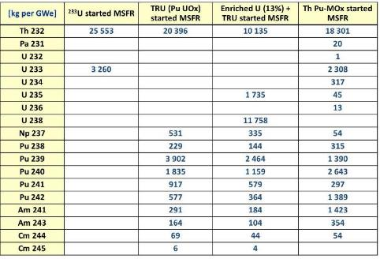
Concept of MSFR: Starting modes and deployment capacities
Which initial fissile load to start a MSFR?
- Start directly ²³³U produced in Gen3+ or Gen4 (included MSFR) reactors
- Start directly with enriched U: U enrichment < 20% (prolif. Issues)
- Start with the Pu of current LWRs mixed with other TRU elements: solubility limit of valence-III elements in LiF
- Mix of these solutions: Thorium as fertile matter +
²³³U + TRU produced in LWRs
MOx-Th in Gen3+ / other Gen4
Uranium enriched (e.g. 13%) + TRU currently produced

Slide 25
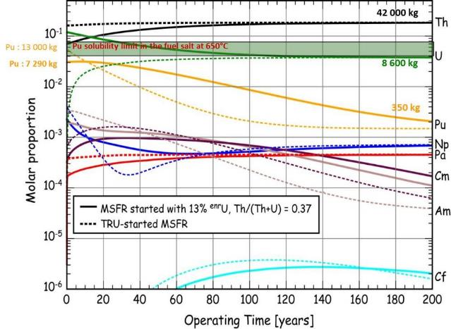
Concept of MSFR: Starting modes and deployment capacities
EVOL : Selection of the optimized fuel salt composition
Optimized initial composition of the fuel salt:
LiF-ThF₄-UF₄-(TRU)F₃ with (77.7-6.7-12.3-3.3 mol%) and U enriched at 13%
Density = 5085.6 - 0.8198*(T/K) - T(solid.) = 867 K
Neutronics, chemical and material behavior very satisfying

Slide 26
Concept of MSFR: Starting modes and deployment capacities
MSFR configurations considered in this deployment scenario:
3 kinds of ²³³U-TRU started MSFR + “incinerator” MSFR (end-of-game studies)
MSFR started with U-Pu-AM + Mox-Th Compositions [kg/GW_{el}]
Z | Initial | 60 years
90 | 18301 | 22817
91 | 20 | 81
92 | 2684 | 4992
93 | 54 | 71
94 | 6034 | 490
95 | 1779 | 72
96 | 54 | 178
MSFR started with 1,5% ²³³U + Pu-AM Uox 50 years Compositions [kg/GW_{el}]
Z | Initial | 60 years
90 | 21493 | 23109
91 | 0 | 82
92 | 1922 | 5083
93 | 372 | 72
94 | 4305 | 298
95 | 778 | 33
96 | 13 | 72
MSFR started with ^{enri}U + TRU (ref EVOL composition) Compositions [kg/GW_{el}]
Z | Initial | 60 years
90 | 9944 | 21851
91 | 0 | 56
92 | 17341 | 7457
93 | 324 | 69
94 | 4552 | 2389
95 | 278 | 153
96 | 47 | 133
MSFR “incinerator” started with transTh from previous MSFR Compositions [kg/GW_{el}]
Z | Initial | 60 years
90 | 0 | 0,3
91 | 1.2 | 1,8
92 | 872 | 4232
93 | 13 | 309
94 | 81 | 1376
95 | 15 | 122
96 | 23 | 398
Very good deployment capacities -
Transition to the Thorium fuel cycle achieved
+ Close the current fuel cycle (reduce the stockpiles of produced transuranic elements)
D. Heuer, E. Merle-Lucotte, M. Allibert, M. Brovchenko, V. Ghetta, P. Rubiolo , “Towards the Thorium Fuel Cycle with Molten Salt Fast Reactors”, Annals of Nuclear Energy 64, 421–429 (2014)

Slide 27
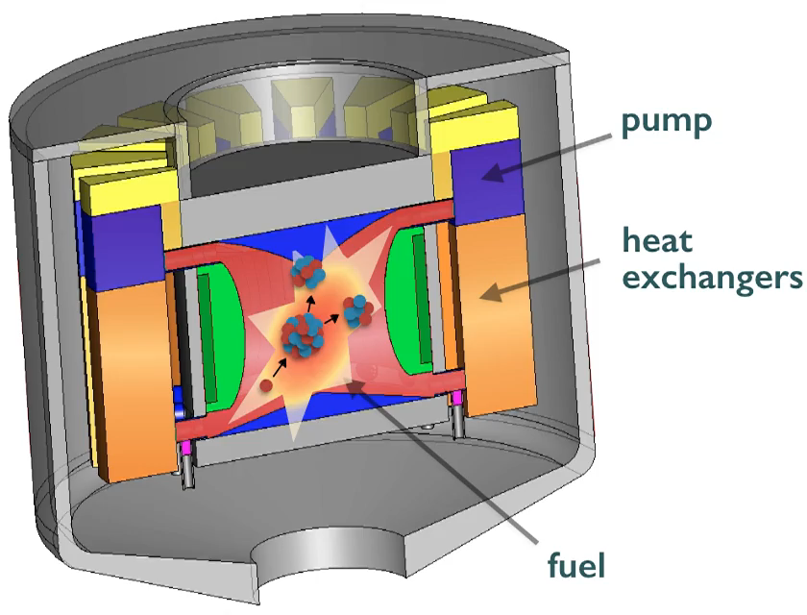
Description of the Molten Salt Fast Reactor (MSFR) system
General characteristics:
  Liquid circulating fuel
  Fuel = coolant
  Power: 3 GW_{th}
  Thermal yield: 45%
  Mean fuel temperature: 725°C
  Fast neutron spectrum
  Thorium fuel cycle
Three circuits:
Fuel salt circuit
27

Slide 28
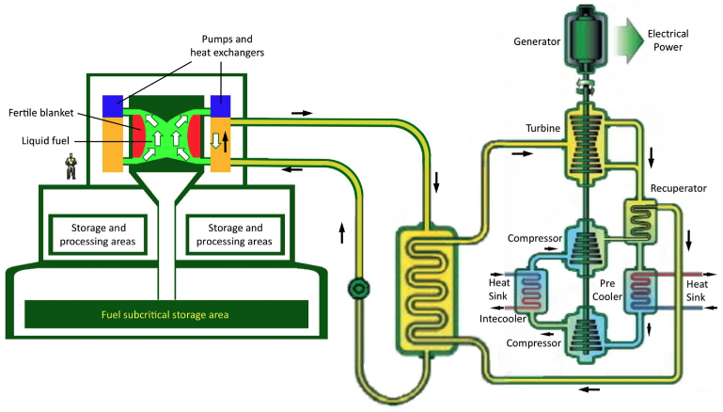
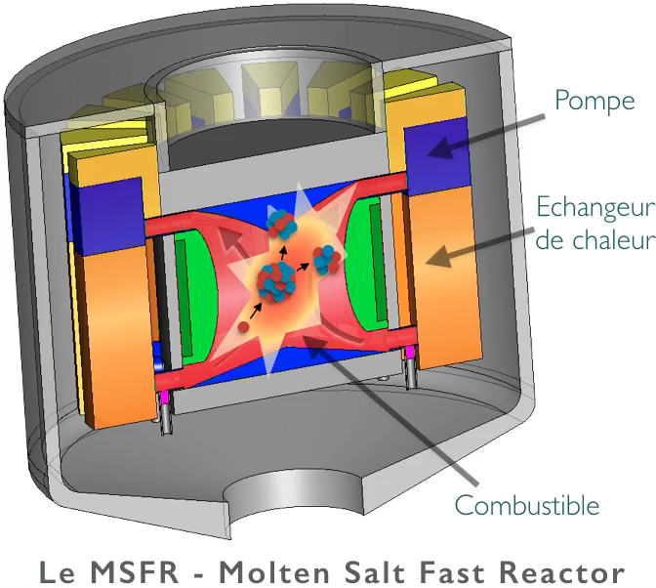
Description of the Molten Salt Fast Reactor (MSFR) system
General characteristics:
  Liquid circulating fuel
  Fuel = coolant
  Power: 3 GW_{th}
  Thermal yield: 45%
  Mean fuel temperature: 725°C
  Fast neutron spectrum
  Thorium fuel cycle
Three circuits:
Fuel salt circuit
Intermediate circuit
Thermal conversion circuit
  + Draining / storage tanks
  + Processing units
R&D activities: multi-disciplinary expertise (reactor physics, chemistry, safety, design, materials…) – Collaborations in a national (CNRS, Universities, AREVA, IRSN, EDF) / European (Euratom EVOL and SAMOFAR projects) / worldwide (GIF, IAEA) frame
M. Allibert, M. Aufiero, M. Brovchenko, S. Delpech, V. Ghetta, D. Heuer, A. Laureau, E. Merle-Lucotte, “Chapter 7 - Molten Salt Fast Reactors”, Handbook of Generation IV Nuclear Reactors, Woodhead Publishing Series in Energy (2015)
28

Slide 29

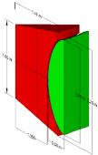

MSFR fuel circuit: characteristics of the reference configuration
Parameter | Value
Thermal/electric power | 3000 MWth / ~1300 MWe
Fuel salt temperature rise in the core (°C) | 100
Fuel molten salt - Initial composition | LiF-ThF₄-²³³UF₄ or LiF-ThF₄-^{enr}UF₄-(Pu-MA)F₃ with 77.5 mol% LiF
Fuel salt melting point (°C) | 585
Mean fuel salt temperature (°C) | 725
Fuel salt density (g/cm³) | 4.1
Fuel salt dilation coefficient (g.cm⁻³/°C) | 8.82 10⁻⁴
Fertile blanket salt - Initial composition (mol%) | LiF-ThF₄ (77.5%-22.5%)
Breeding ratio (steady-state) | 1.1
Total feedback coefficient (pcm/°C) | -8
Toroidal core dimensions (m) | Radius: 1.06 to 1.41 Height: 1.6 to 2.26
Fuel salt volume (m³) | 18 (1/2 in the core)
Total fuel salt cycle in the fuel circuit | 3.9 s
Intermediate fluid | fluoroborate (8NaF-92NaBF₄), FLiNaK, LiF-ZrF₄, FLiBe
MSFR design characteristics impacting strongly the reactor operation: fuel = coolant + no control rod foreseen in the core & reactor driven by the heat extraction…
⇨ Require the definition and assessment of the normal operation procedures and of a safety approach dedicated to the MSFR (liquid circulating fuel reactor)
29

Slide 30


Concept of Molten Salt Fast Reactor (MSFR)
SAMOFAR Project – Horizon2020
Safety Assessment of a MOlten salt FAst Reactor
4 years (2015-2019), 3,5 M€
Partners: TU-Delft (leader Pr. Kloosterman), CNRS, JRC-ITU, CIRTEN (POLIMI, POLITO), IRSN, AREVA, CEA, EDF, KIT + PSI + CINVESTAV
SAMOFAR will deliver the experimental proof of the following key safety features:
The freeze plug and draining of the fuel salt
New materials and new coatings to materials
Measurement of safety related data of the fuel salt
The dynamics of natural circulation of (internally heated) fuel salts
The reductive extraction processes to extract lanthanides and actinides from the fuel salt
5 technical work-packages:
WP1 Integral safety approach and system integration
WP2 Physical and chemical properties required for safety analysis
WP3 Proof of concept of key safety features
WP4 Numerical assessment of accidents and transients
WP5 Safety evaluation of the chemical processes and plant

Slide 31
Nuclear safety: fundamentals
Specificities of a nuclear reactor:
Huge energy reserve concentrated in the fuel
Accumulation of radioactive elements (dangerous + produce heat)
Large release of energy even after the reactor shutdown
Bases of the nuclear safety = control the reactor – 3 safety functions:
Control of the chain reaction at any time = drive the reactor
Heat evacuation even after the chain reaction stops (residual heat management)
Confinement of the radioactive elements (= 3 barriers in LWRs)

Slide 32
Design aspects impacting the MSFR safety analysis
Liquid fuel
      Molten fuel salt acts as reactor fuel and coolant
      Relative uniform fuel irradiation
      A significant part of the fissile inventory is outside the core
      Fuel reprocessing and loading during reactor operation
PhD theses of Mariya Brovchenko and Delphine Gérardin
  Design definition (core and draining system at least)
  Definition of the normal operation procedures
  Safety evaluation: accident initiators? Accident scenarios?
  Safety approach: severe accident? Barriers? Reactivity control?
No control rods in the core
    Reactivity is controlled by the heat transfer rate in the HX + fuel salt feedback coefficients, continuous fissile loading, and by the geometry of the fuel salt mass
    No requirement for controlling the neutron flux shape (no DNB, uniform fuel irradiation, etc.)
Fuel salt draining
    Cold shutdown is obtained by draining the molten salt from the fuel circuit
    Changing the fuel geometry allows for adequate shutdown margin and cooling
    Fuel draining can be done passively or by operator action in 2 dedicated systems (normal operation storage system and emergency draining system)
M. Brovchenko, D. Heuer, E. Merle-Lucotte, M. Allibert, V. Ghetta, A. Laureau, P. Rubiolo, “Design-related Studies for the Preliminary Safety Assessment of the Molten Salt Fast Reactor”, Nuclear Science and Engineering,175, 329–339 (2013)

Slide 33

Concept of MSFR: SAMOFAR WP1 ”Integral safety approach and system integration”
Del. n° | Deliverable title | Lead benef. | Delivery date
D1.1 | Description of initial reference design and identification of safety aspects | CNRS | Month 6
D1.2 | Identifying safety related physico-chemical and material data | JRC | Month 6
D1.3 | Development of a power plant simulator | CNRS | Month 24
D1.4 | Safety issues of normal operation conditions, including start, shut-down and load-following | CIRTEN | Month 30
D1.5 | Development on an integral safety assessment methodology for MSR | IRSN | Month 36
D1.6 | Identification of risks and phenomena involved, identification of accident initiators and accident scenarios | CIRTEN | Month 36
D1.7 | Improved Integral power plant design (reactor core and chemical plant) to maximize safety and proposal for safety demonstrator | CNRS | Month 48

Slide 34
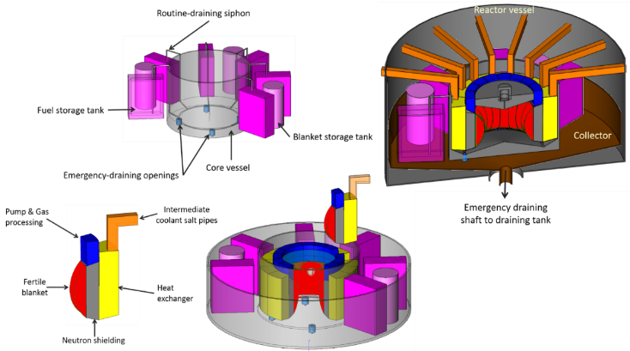
Design aspects impacting the MSFR safety analysis
  LOLF accident (Loss of Liquid Fuel) → no tools available for quantitative analysis but qualitatively:
    Fuel circuit: complex structure, multiple connections
    Potential leakage: collectors connected to draining tank
  → Proposition of an ‘Integrated MSFR design’ to suppress pipes/leaks

Slide 35
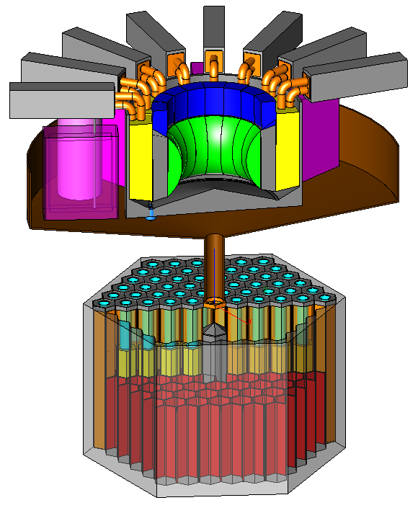
Concept of MSFR: Emergency Draining System
EDS roles
  Contain the fuel in case of leak
  Drain the fuel in case of severe anomaly in the core
  Reversible: recover the fuel salt to re-start the reactor
EDS sub-systems
  Opening devices at the bottom of the core
    Active systems
    Passive systems activated by an excessive fuel temperature
  Transfer system (collector + draining shaft)
  Emergency Draining Tank
Redundant and reliable systems
Collector
Opening devices
Draining shaft
Functions to be ensured in the EDS
  The system must be subcritical in all circumstances
  The system must be able to evacuate the residual power over a long time period
  The system must be leak-proof
Draining Tank
@ M. Allibert

Slide 36
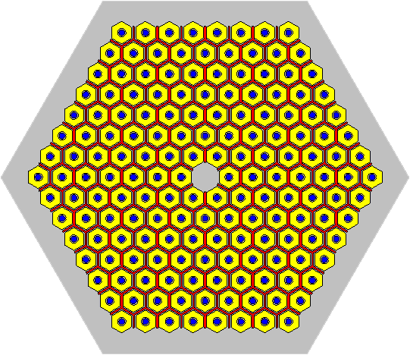

Concept of MSFR: Emergency Draining System
EDS sub-systems
  Opening devices at the bottom of the core
  Transfer system (collector + draining shaft)
  Emergency Draining Tank
Draining Tank
Draining tank geometry
  Hexagonal tank
  Contains hexagonal cooling rods
    Cooling fluid
    Inert salt
      Fusible material: store heat as latent fusion heat
      Reduce the power to be evacuated by the cooling system
      Increase the system’s thermal inertia: maintain the fuel at liquid state as long as possible
    Metallic walls
  Fuel salt stored between cooling rods
@ D. Gérardin
Metallic walls
Cooling fluid
Fuel salt
Inert salt

Slide 37
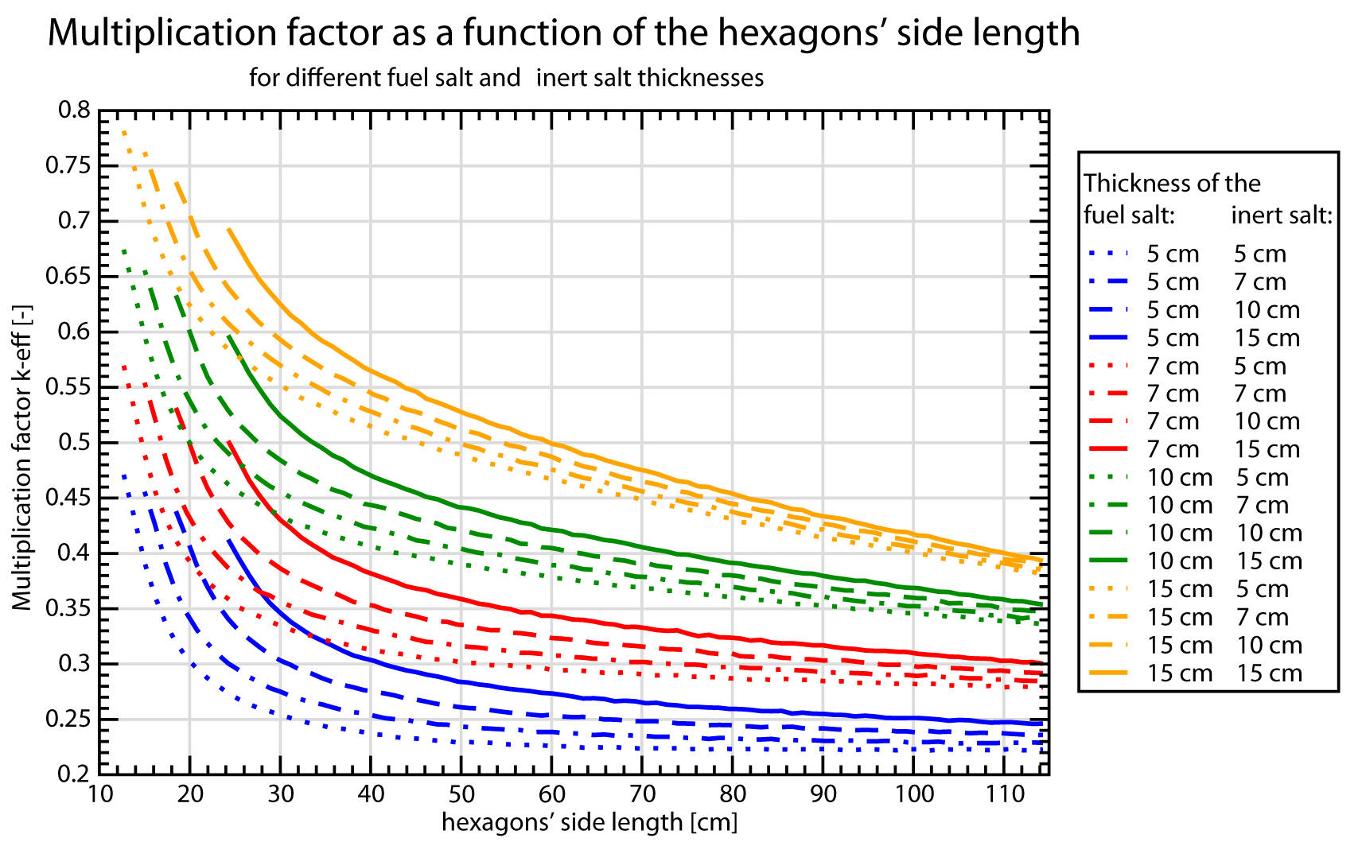

Concept of MSFR: Emergency Draining System
Criticality study in the draining tank
All configurations ensure sub-criticality with a sufficient margin
Fixed parameter
  Wall thickness: 3 cm
  Number of cooling rods
Configuration studied
  Fuel salt layer thicknesses (5cm, 7cm, 10 cm, 15 cm)
  Inert salt layer thicknesses (5cm , 7cm , 10 cm , 15 cm )
Variable parameter
  Hexagon side length
@ D. Gérardin
D. Gérardin, M. Allibert, D. Heuer, A. Laureau, E. Merle-Lucotte, C. Seuvre, "Design Evolutions of the Molten Salt Fast Reactor", FR17 International Conference, Yekaterinburg, Russia Federation, 2017
37

Slide 38
Concept of MSFR: SAMOFAR WP1 ”Integral safety approach and system integration”
Del. n° | Deliverable title | Lead benef. | Delivery date
D1.1 | Description of initial reference design and identification of safety aspects | CNRS | Month 6
D1.2 | Identifying safety related physico-chemical and material data | JRC | Month 6
D1.3 | Development of a power plant simulator | CNRS | Month 24
D1.4 | Safety issues of normal operation conditions, including start, shut-down and load-following | CIRTEN | Month 30
D1.5 | Development on an integral safety assessment methodology for MSR | IRSN | Month 36
D1.6 | Identification of risks and phenomena involved, identification of accident initiators and accident scenarios | CIRTEN | Month 36
D1.7 | Improved Integral power plant design (reactor core and chemical plant) to maximize safety and proposal for safety demonstrator | CNRS | Month 48

Slide 39

Operation aspects impacting the MSFR safety analysis
MSFR characteristics ⇨ Require the definition and assessment of the normal operation procedures dedicated to the MSFR (liquid circulating fuel reactor)
Normal operation modes: load following
Idea = accomplish load following without using control rods, by varying the power extracted from the core while keeping the structure materials temperature as constant as possible
For this, several levers available, among which:
The fuel salt circulation speed which can be adjusted by controlling the power of the pumps in each sector
The intermediate fluid circulation speed which can be adjusted by controlling the power of the intermediate circuit pumps
The temperature of the intermediate fluid in the intermediate exchangers. This temperature can be controlled by means of a double bypass. With this procedure, the temperature of the intermediate fluid at the conversion exchanger inlet can be kept constant while its temperature is increased in a controlled manner at the inlet of the intermediate exchangers.
If necessary the temperature in the core may also be adjusted by varying the proportion of bubbles injected in the core. The injection of bubbles reduces the salt density and, as a consequence, reduces the mean temperature of the fuel salt. Typically, a 3% proportion of bubbles lowers the fuel salt temperature by 100°C.
Precise transient calculations (core scale) performed → development and validation of dedicated simulation tools (see TFM-OpenFOAM coupling)
System code (plant simulator) under development to study and define more precisely these operation procedures

Slide 40

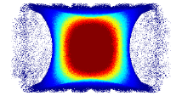









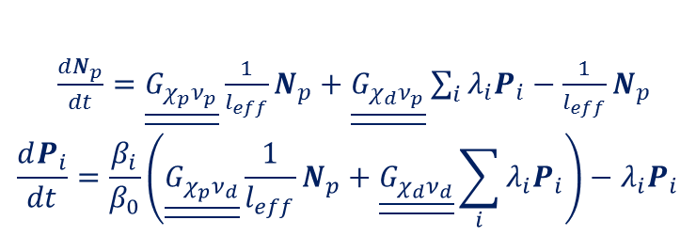
Concept of MSFR: transient calculations – the Transient Fission Matrix (TFM) approach
A. Laureau et al, “Transient Fission Matrix: kinetic calculation and kinetic parameters βeff and Λeff calculation”, Annals of Nuclear Energy, vol 85, p.1035–1044 (2015)
A. Laureau et al, “Local correlated sampling Monte Carlo calculations in the TFM neutronics approach for spatial and point kinetics applications”, accepted in EPJ-N (2017)
TFM kinetic equations (prompt/delayed neutrons):
$\frac{dN_{p}}{dt}=\underline{\underline{G_{χ_{p}ν_{p}}}}\frac{1}{l_{eff}}N_{p}+\underline{\underline{G_{χ_{d}ν_{p}}}}\sum_{i}{λ_{i}P_{i}}−\frac{1}{l_{eff}}N_{p}$
$$\frac{dP_{i}}{dt}=\frac{β_{i}}{β_{0}}\left(\underline{\underline{G_{χ_{p}ν_{d}}}}\frac{1}{l_{eff}}N_{p}+\underline{\underline{G_{χ_{d}ν_{d}}}}\sum_{i}{λ_{i}P_{i}}\right)−λ_{i}P_{i}$$
SERPENT
(Monte Carlo calculation code)
temperature
buoyancy effect
precursor production
Fission matrices + Time matrix calculation
power
TFM
(new model)
CFD
k-ε realizable
turbulence model
delayed neutron source
Doppler feedback effect
density feedback effect
temperature field
precursor decay position
TFM kinetic equations directly implemented and solved in
TFM mesh
CFD mesh
performed by
PhD thesis of Axel LAUREAU, Grenoble Alpes University, France (2012-2015)
OpenFOAM

Slide 41

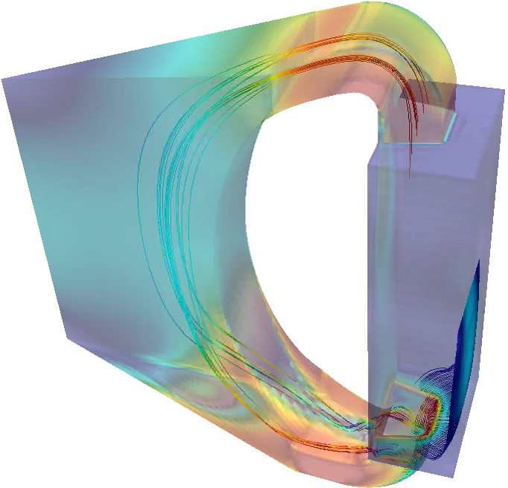
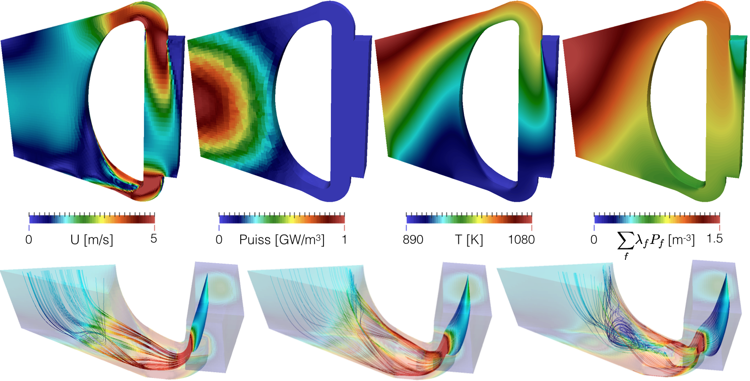





Concept of MSFR: transient calculations – the Transient Fission Matrix (TFM) approach
Step 1 - equilibrium solution:
fixed known parameters
3GW, average temperature 973 K, circulation time 4s, …
iterations over problem parameters
temperature distribution, pump power, …
Step 2 - transient studies:
load following (normal operation)
power extraction modification via the intermediate fluid temperature
overcooling (accident)
fast modification of the intermediate temperature
reactivity insertion (accident)
“artificial” increase of the multiplication factor
Etape 2 - étude de transitoires :
Suivi de charge (fonctionnement normal)
modification de la puissance extraite via la température du fluide intermédiaire
Sur-refroidissement (accident)
modification instantanée du la température du fluide intermédiaire
Core
Heat Exchanger
initialise
[m⁻³]
0
Velocity [m/s]
Power [GW/m³]
890
1080
0
1.5
5
0
1
Tfuel [K]

Slide 42

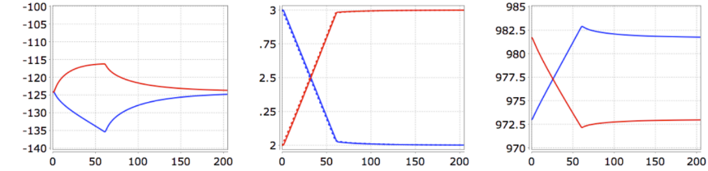
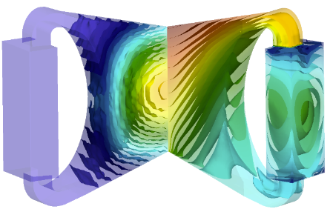
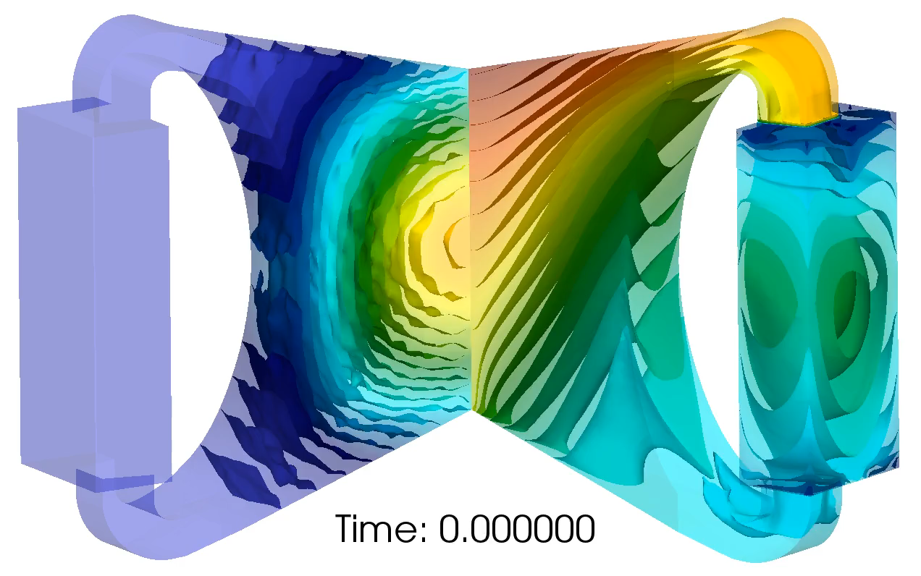
Concept of MSFR: the TFM approach – Application to transient calculations (load following of 33% in 60s)
❗️
2→3 GW
2/ Feedback effect
kp−1 [pcm]
Power [GW]
3/ Power increase
Tmoy fuel [K]
1/ cooling
Conclusions:
Nuclear heat deposited directly in the coolant
The produced power exactly follow the extracted power: reactor flexible and well adapted for load following for neutronic/t&h issues
Load following driven by the extracted power only (no control rods needed)
Confirm the excellent load following capacities of the MSFR core
3→2 GW
Time [s]
Time [s]
Time [s]
Power
[GW/m³]
Fuel Temperature
[K]
1
1110
@ A. Laureau
0
890
t=0 s
2→3 GW
2→3 GW
Axel LAUREAU, "Développement de modèles neutroniques pour le couplage thermohydraulique du MSFR et le calcul de paramètres cinétiques effectifs", PhD Thesis, Grenoble Alpes University, France (2015)
41

